Slide 1
Chapter 4
Screen Designing

Slide 2
Design Goals
Reduce visual work.
Reduce intellectual work.
Reduce memory work.
Reduce motor work.
Minimize or eliminate any burdens or instructions imposed by technology.
The result will always be improved user productivity and increased satisfaction. Let’s begin our review of the principles of good design by applying the following sim- ple test to all screens.

Slide 3
Screen Meaning and Purpose
Each screen element . . .
— Every control
— All text
— The screen organization
— All emphasis
— Each color
— Every graphic
— All screen animation
— Each message
— All forms of feedback
Must . . .
— Have meaning to screen users.
— Serve a purpose in performing tasks.

Slide 4
Organizing Screen Elements Clearly and Meaningfully
Consistency in Design
Visually pleasing composition
Logical and sequential ordering
The presentation of proper amount of information
Groupings
Alignment of screen items

Slide 5
All elements of a screen must have meaning to users and serve a purpose in per- forming tasks or fulfilling needs. If an element does not have meaning, do not include it on the screen because it is noise. Noise is distracting, competes for the screen user’s at- tention, and contributes to information overload. That which is important will be more difficult to find.
Organizing Screen Elements Clearly and Meaningfully
Visual clarity is achieved when the display elements are organized and presented in meaningful and understandable ways. A clear and clean organization makes it easier to recognize screen’s essential elements and to ignore its secondary information when appropriate. Clarity is influenced by a multitude of factors: consistency in design, a vi- sually pleasing composition, a logical and sequential ordering, the presentation of the proper amount of information, groupings, and alignment of screen items.
Consistency
Provide real-world consistency. Reflect a person’s experiences, expectations, work conventions, and cultural conventions.
Provide internal consistency. Observe the same conventions and rules for all as- pects of an interface screen, and all application or Web site screens, including:
Follow the same conventions and rules across all related interfaces.
Deviate only when there is a clear benefit for the user.

Slide 6
Ordering of Screen Data and Content
Divide information into units that are logical, meaningful, and sensible.
■ Organize by the degree interrelationship between data or information.
■ Provide an ordering of screen units of information and elements that is prioritized
according to the user’s expectations and needs.
■ Possible ordering schemes include:
— Conventional.
— Sequence of use.
— Frequency of use.
— Function.
— Importance.
— General to specific.
■ Form groups that cover all possibilities.
■ Ensure that information that must be compared is visible at the same time.
■ Ensure that only information relative to the users tasks or needs is presented on the
screen.

Slide 7
Screen Navigation and Flow
Provide an ordering of screen information and elements that:
— Is rhythmic, guiding a person’s eye through the display.
— Encourages natural movement sequences.
— Minimizes pointer and eye movement distances.
Locate the most important and most frequently used elements or controls at the top
left.
Maintain a top-to-bottom, left-to-right flow.
Assist in navigation through a screen by:
— Aligning elements.
— Grouping elements.
— Using of line borders.
Through focus and emphasis, sequentially, direct attention to items that are:
1. Critical.
2. Important.
3. Secondary.
4. Peripheral.
Tab through window in logical order of displayed information.
Locate command buttons at end of the tabbing order sequence.
When groups of related information must be broken and displayed on separate
screens, provide breaks at logical or natural points in the information flow.

Slide 8
Visually Pleasing Composition
Visually pleasing composition with the following qualities:
— Balance.
— Symmetry.
— Regularity.
— Predictability.
— Sequentiality.
— Economy.
— Unity.
— Proportion.
— Simplicity.
— Grouping

Slide 9
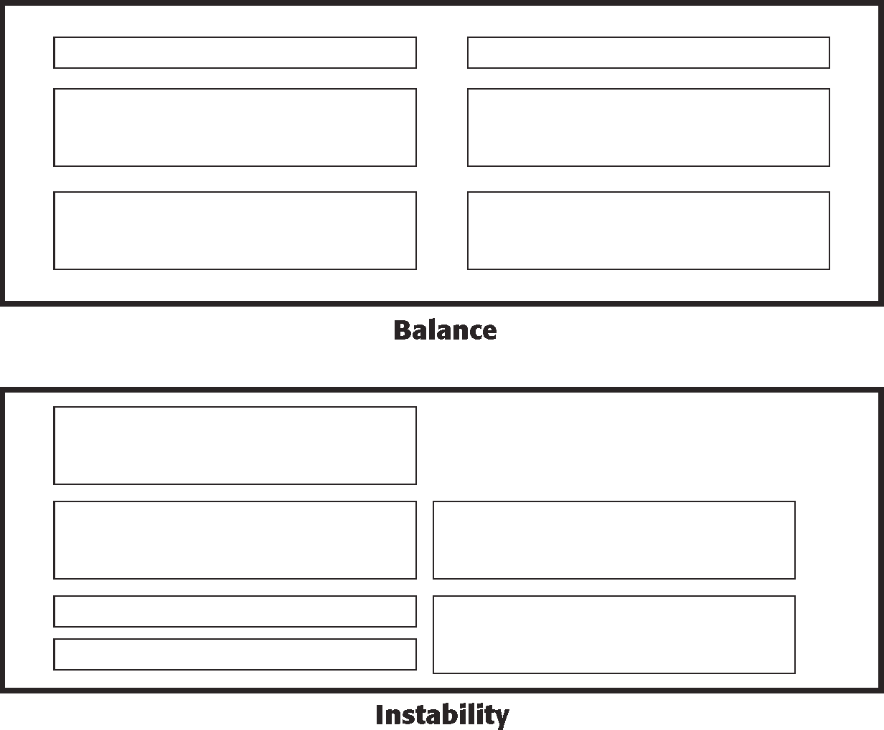
Balance
Create screen balance by providing an equal weight of screen elements, left and right, top and bottom.
Balance, illustrated in Figure, is stabilization or equilibrium, a midway center of suspension. The design elements have an equal weight, left to right, top to bottom. The opposite of balance is instability; the design elements seemingly ready to topple over.
Balance
Instability
Figure Balance (versus instability).

Slide 10
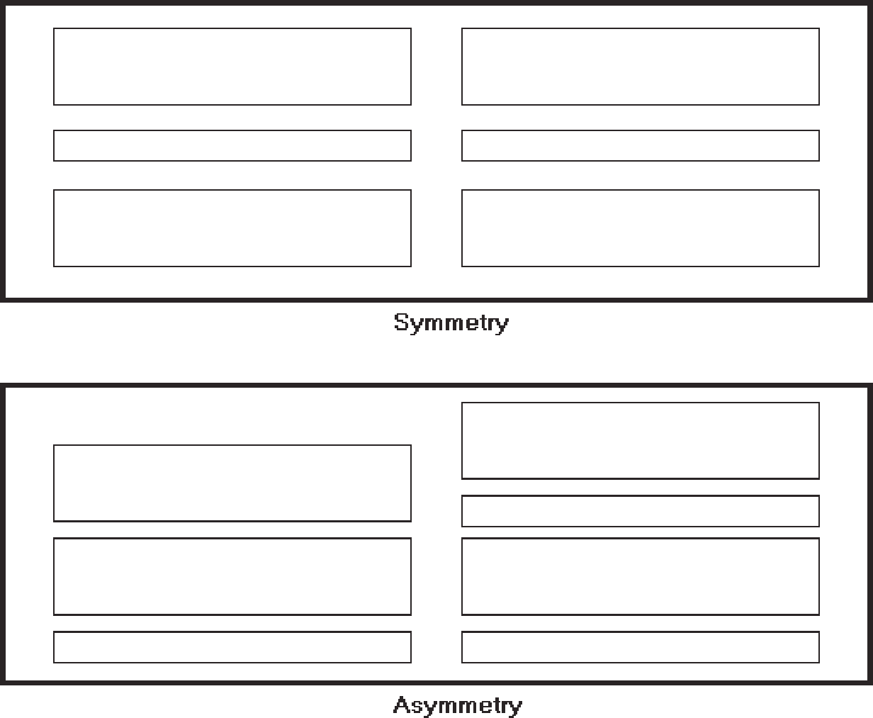
Dark colors, unusual shapes, and larger objects are “heavier,” whereas light colors, regular shapes, and small objects are “lighter.” Balance on a screen is accomplished through centering the display itself, maintaining an equal weighting of components on each side of the horizontal and vertical axis, and centering titles and illustrations
In Web page design, vertical, or left-to-right balance is usually the most important concept. Web pages are often scrollable thereby shifting the horizontal, or top-to- bottom, balance point as the screen is scrolled. Horizontal balance is therefore more dif- ficult to maintain.
Symmetry
Create symmetry by replicating elements left and right of the screen centerline.
Symmetry, illustrated in Figure, is axial duplication: A unit on one side of the cen- terline is exactly replicated on the other side. This exact replication creates formal bal- ance, but the difference is that balance can be achieved without symmetry. Symmetry’s
Symmetry
Asymmetry
Figure Symmetry (versus asymmetry).

Slide 11
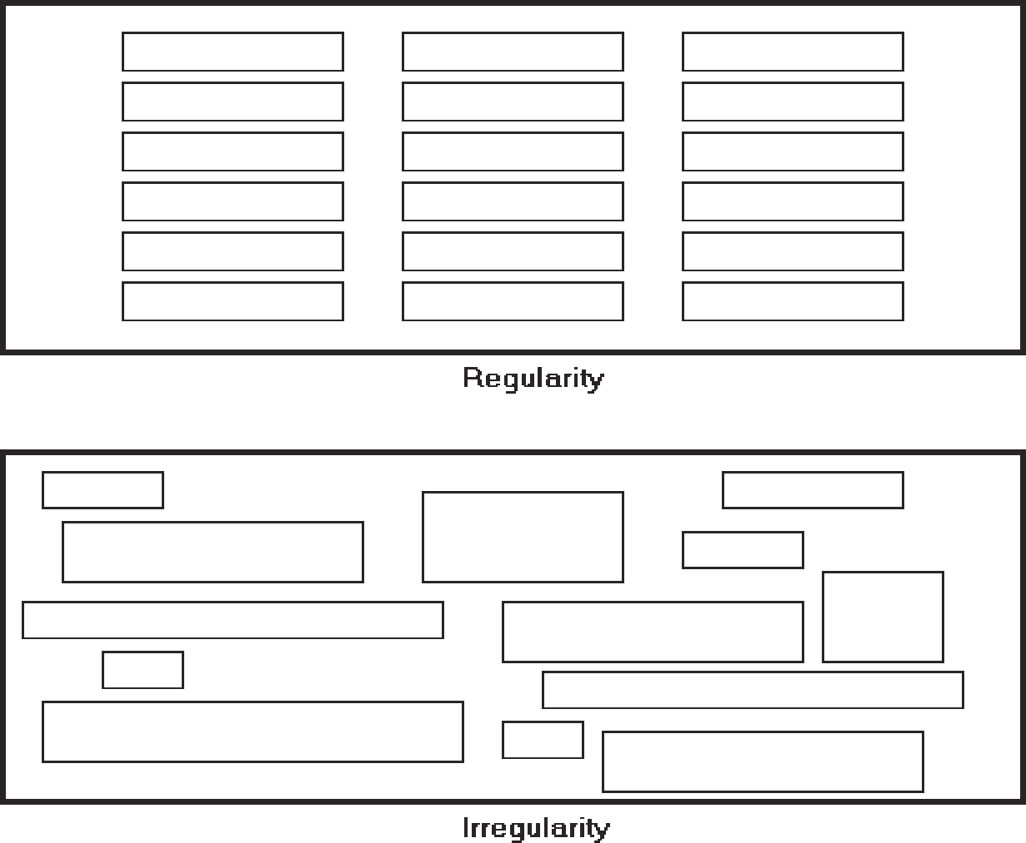
Regularity
Create regularity by establishing standard and consistently spaced horizontal and vertical alignment points.
Regularity, illustrated in Figure, is a uniformity of elements based on some prin- ciple or plan. Regularity in screen design is achieved by establishing standard and con- sistently spaced column and row starting points for screen elements. It is also achieved by using elements similar in size, shape, color, and spacing. The opposite of regularity, irregularity, exists when no such plan or principle is apparent. A critical element on a screen will stand out better, however, if it is not regularized
Predictability
Create predictability by being consistent and following conventional orders or arrangements.
Regularity
Irregularity

Slide 12
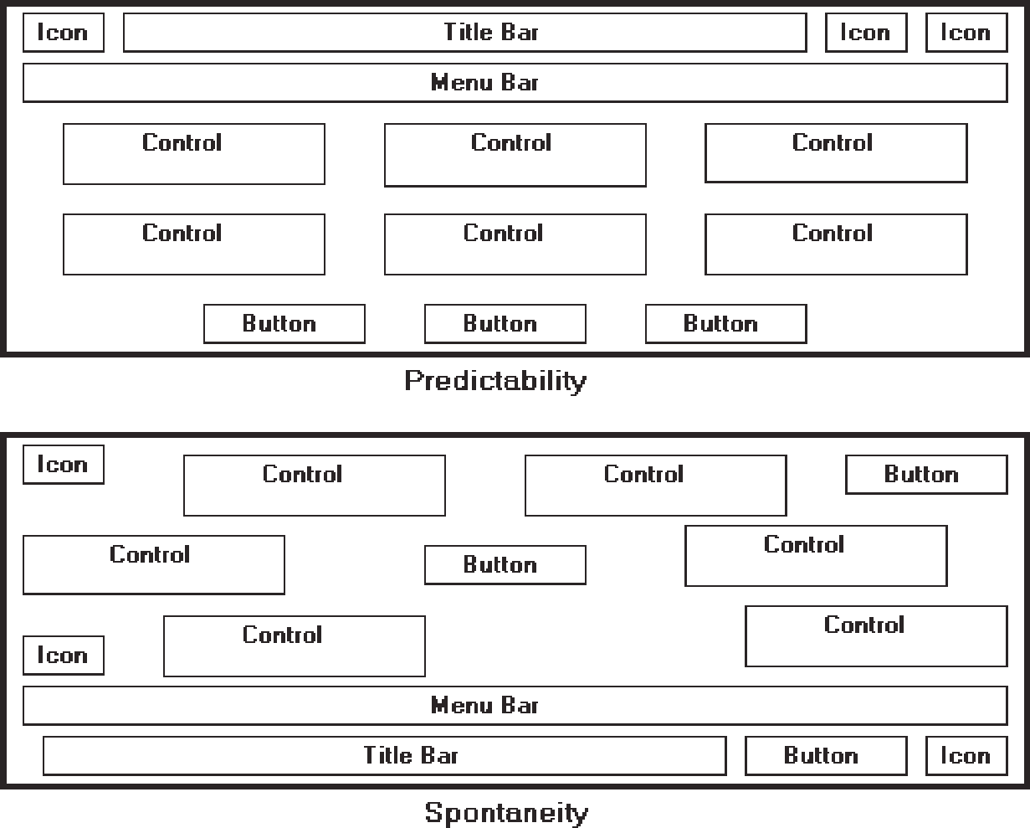
Predictability
Spontaneity
Figure Predictability (versus spontaneity).
Predictability, illustrated in Figure, suggests a highly conventional order or plan. Viewing one screen enables one to predict how another will look. Viewing part of a screen enables one to predict how the rest of the screen will look. The opposite of pre- dictability—spontaneity—suggests no plan and thus an inability to predict the struc- ture of the remainder of a screen or the structure of other screens. In screen design predictability is also enhanced through design consistency.
Sequentiality
Provide sequentiality by arranging elements to guide the eye through the screen in an obvious, logical, rhythmic, and efficient manner.
The eye tends to be attracted to:
A brighter element before one less bright.
Isolated elements before elements in a group.
Graphics before text.
Color before black and white.
Highly saturated colors before those less saturated.
Dark areas before light areas.
A big element before a small one.
An unusual shape before a usual one.
Big objects before little objects.

Slide 13
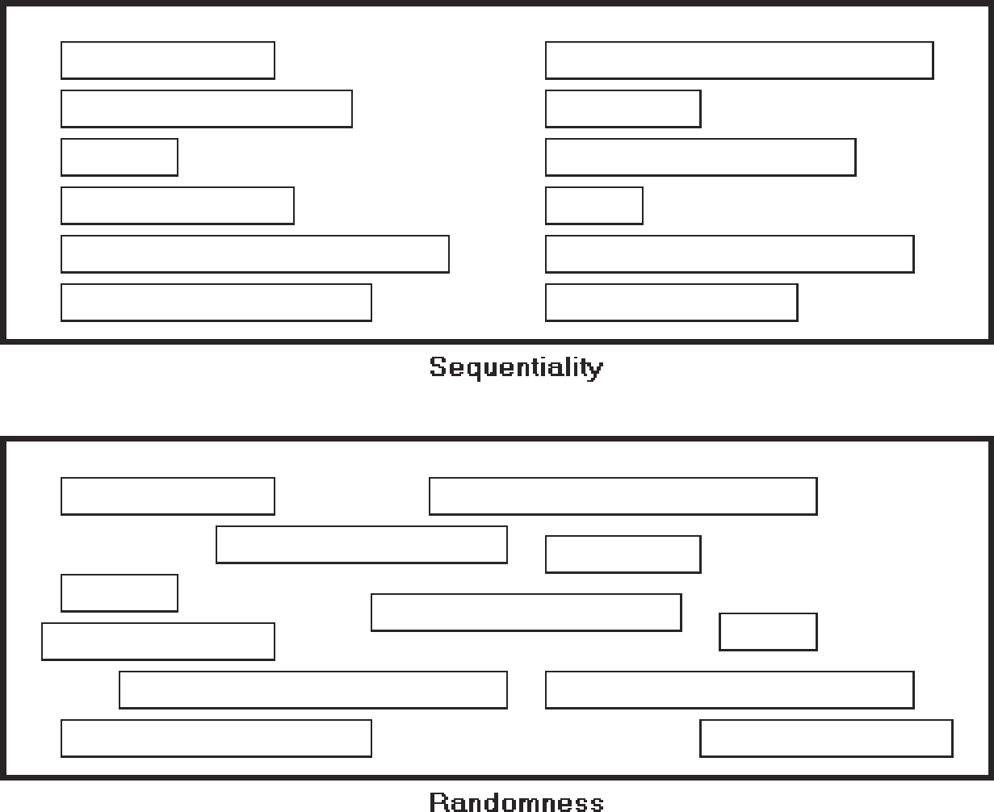
Sequentiality
Sequentiality, illustrated in Figure s a plan of presentation to guide the eye through the screen in a logical, rhythmic order, with the most important information significantly placed. Sequentiality can be achieved by alignment, spacing, and group- ing as illustrated. The opposite of sequentiality is randomness, whereby an arrange- ment and flow cannot be detected.
.
Economy
Provide economy by using as few styles, display techniques, and colors as possible.
Economy, illustrated in Figure is the frugal and judicious use of display elements to get the message across as simply as possible. The opposite is intricacy, the use of many elements just because they exist. The effect of intricacy is ornamentation, which often detracts from clarity. Economy in screen design means mobilizing just enough display elements and techniques to communicate the desired message, and no more. Historically, the use of color in screens has often violated this principle, with screens sometimes taking on the appearance of Christmas trees.

